Slide 1
Web Development Task
By: Mohmed I Patel
Domain: Web Development
Batch: Jan 1st 2025-31st jan2025
Company: ShadowFox
Gihub: Click here for github repo
Demo: Click here for live demo

Slide 2
Index
Sir no. | Topic | Slide no.
1 | Acknowledgement | 1
2 | Task Information | 2
3 | Screenshots | 4

Slide 3
Acknowledgement
I would like to express my sincere gratitude to ShadowFox for the opportunity to intern with such an innovative team. A special thanks to my supervisor, Mr Aakash, for their guidance and support throughout my internship. This internship has significantly enhanced my skills and passion for Web Development. Thank you, ShadowFox, for an unforgettable experience!

Slide 4
Beginner Level Task: Personal Portfolio Website
Technologies Used for Development
1. React js
2. Bootstrap
3. Css

Slide 5
Task and Responsibilities
1. Front-End Development
Built interactive and dynamic components using React.js, leveraging hooks like useState and useEffect.
Developed reusable components for sections like the header, projects, skills, and contact forms.
Integrated React Router for smooth navigation across different pages.
2. Version Control and Collaboration
Used Git and GitHub for version control to track changes and maintain a clean project history.
3. UI/UX Design
Implemented responsive web designs using React, CSS, and Bootstrap, ensuring cross-device compatibility.

Slide 6
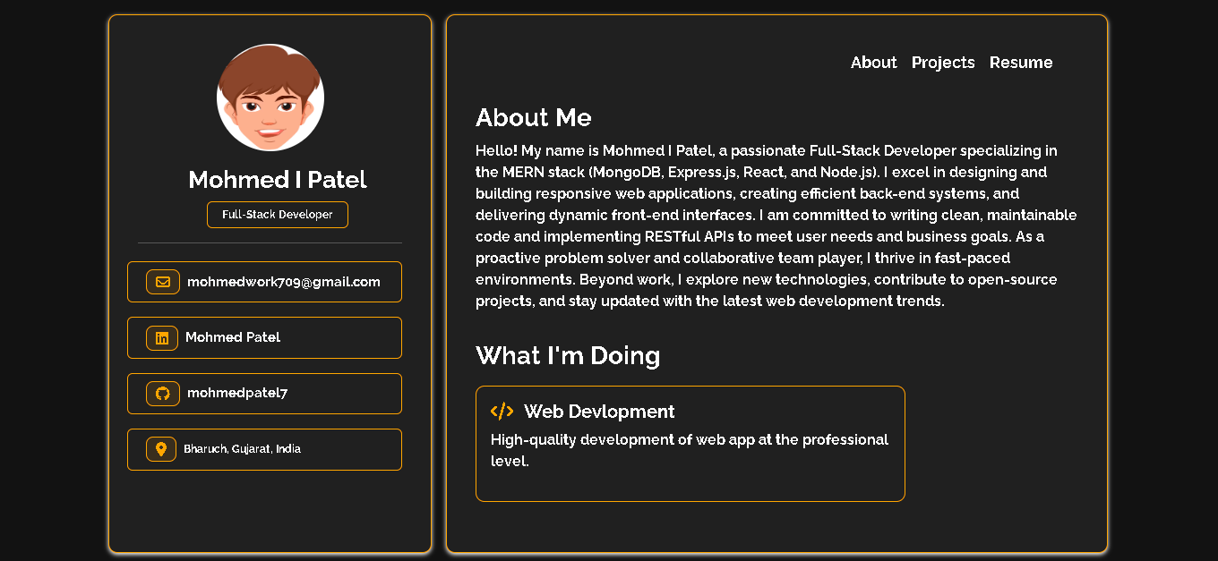
Screenshots

Slide 7
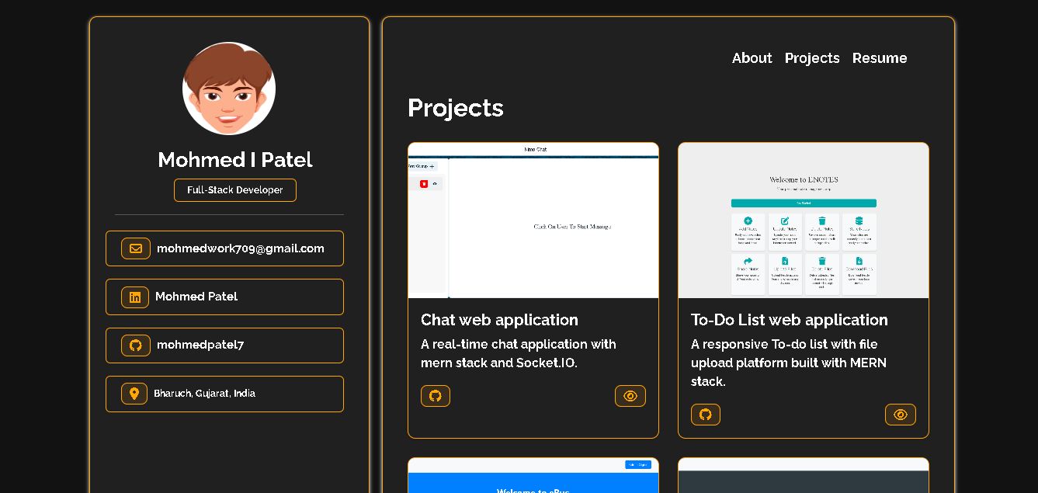

Slide 8
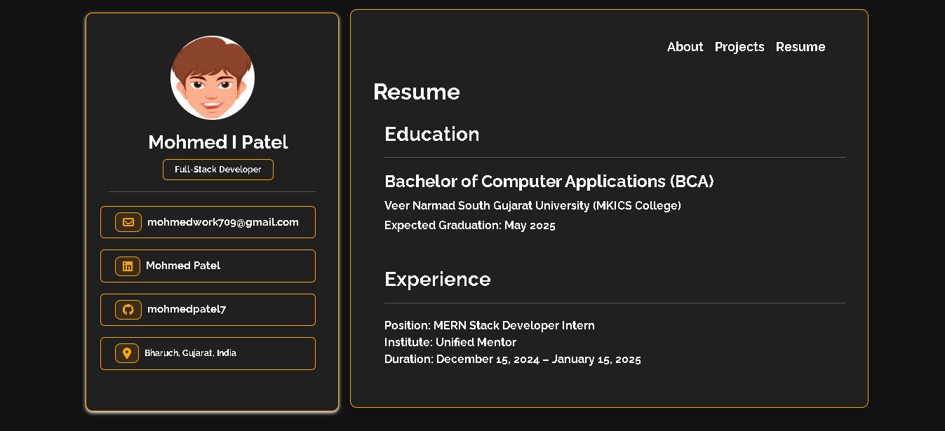

Slide 9
The End

